Slide 1

Recap: ComSciCon Houston 2019
James Gerity and Tarini Konchady
April 25, 2019
Slides available at http://www.github.com/jgerity/talks

Slide 2
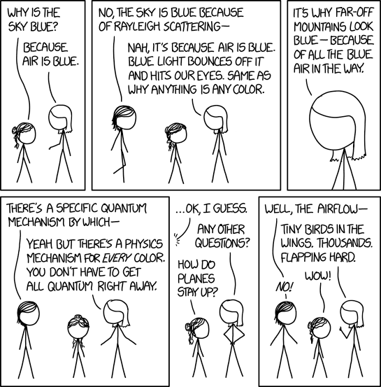
Image from https://xkcd.com/1818/ under CC BY-NC 2.5

Slide 3
What is ComSciCon?
“a series of workshops focused on the communication of complex and technical concepts organized by graduate students, for graduate students”
Annual flagship and local workshops across the US and Canada

Slide 4
ComSciCon Houston overview
J
$50 registration deposit
refunded if you participate!
2 Saturdays full of talks/discussion/demos
Write-a-thon
First Saturday: write draft
Week in-between: peer review and revision
Second Saturday: expert review

Slide 5
Day 1

Slide 6
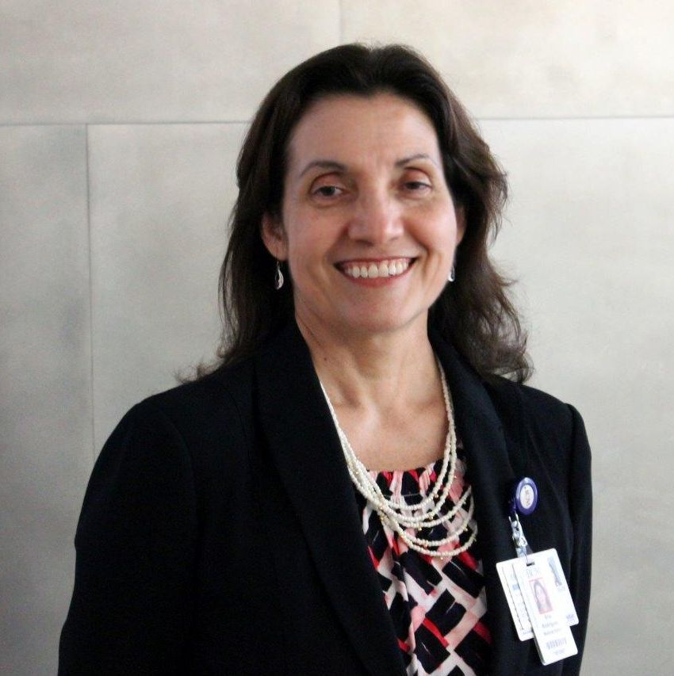
Basics of Science Writing
J
Ana Rodriguez (@AnaRodWrites)
Director of Baylor College of Medicine blog “From the Labs”
“I started pretty much where you are right now.”

Slide 7
Basics of Science Writing
J
“I started pretty much where you are right now.”
“Before writing, decide…”
Topic: what will you communicate?
Audience: to whom are you communicating?
Range: how deep will you go?
Outlet: where/how will your message be spread?
“People are smart, don’t underestimate them”
Recommended targeting 8th grade reading level for major news media

Slide 8
Basics of Science Writing
J
“Engage readers from the beginning…how does the topic relate to them?”
Recommended the writings of Carl Zimmer and Ed Young as exemplary
BIG IDEAS
Engagement
Specificity
small ideas

Slide 9
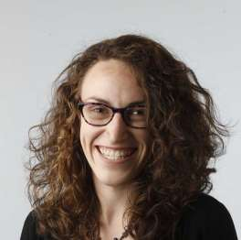
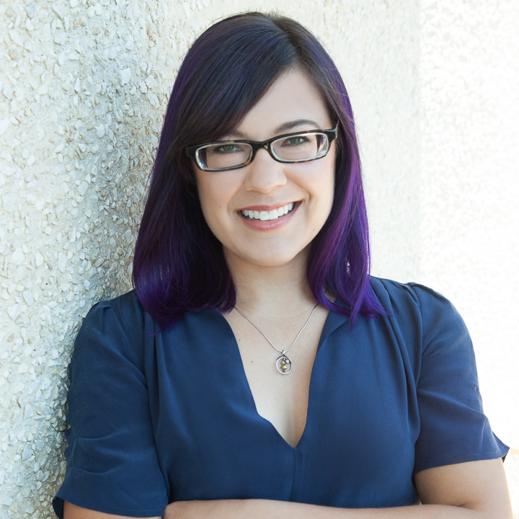
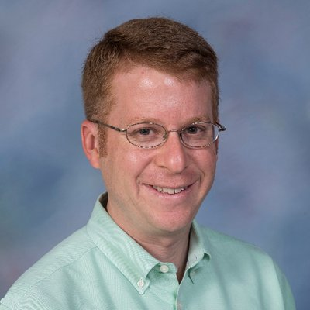
Panel: Science Communication and Science Writing
T
Alex Stuckey (@alexdstuckey)
Pulitzer Prize winning reporter on NASA, sci/environ. for Houston Chronicle
Liz Kruesi (@LyraLunaris)
Freelance writer, formerly with Astronomy Magazine
Dan Cohan (@cohan_ds)
Assoc. Prof., Rice
Notes:
TALK TO EXPERTS. Make sure you’re not misrepresenting anything as you write about it

Slide 10
Panel: Science Communication and Science Writing
J
We both spoke with Liz Krusei after this panel
Used to be an astronomy grad student
Spoke frankly with us about what entering scicomm is like, had advice about a few outlets.
Learned that she’s a ring-leader for @ATXSciWri, which holds regular events

Slide 11
Workshop: Practice interviews
J
T
Not focused exclusively on research!
It’s polite to ask ahead of the interview if a question may be hard or upsetting to answer.
“The listener is the star of the show” – C.C.
“Is there anything I didn’t ask but should have?”
“Must-ask” question

Slide 12
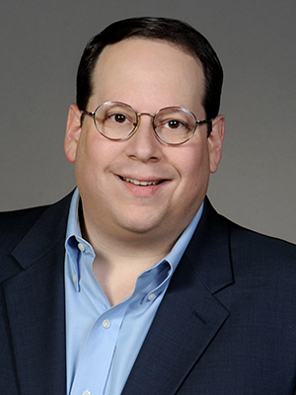
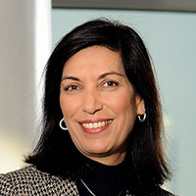
Workshop: Practice interviews
J
T
Craig Cohen (@CohenCraig), host of Houston Matters interviewed Dr. Huda Zoghbi about her work on Rett syndrome
“What is a pedigree?” [complex answer] “…and what does that tell you?”
Notes:
Holy acronym alert, Batman

Slide 13
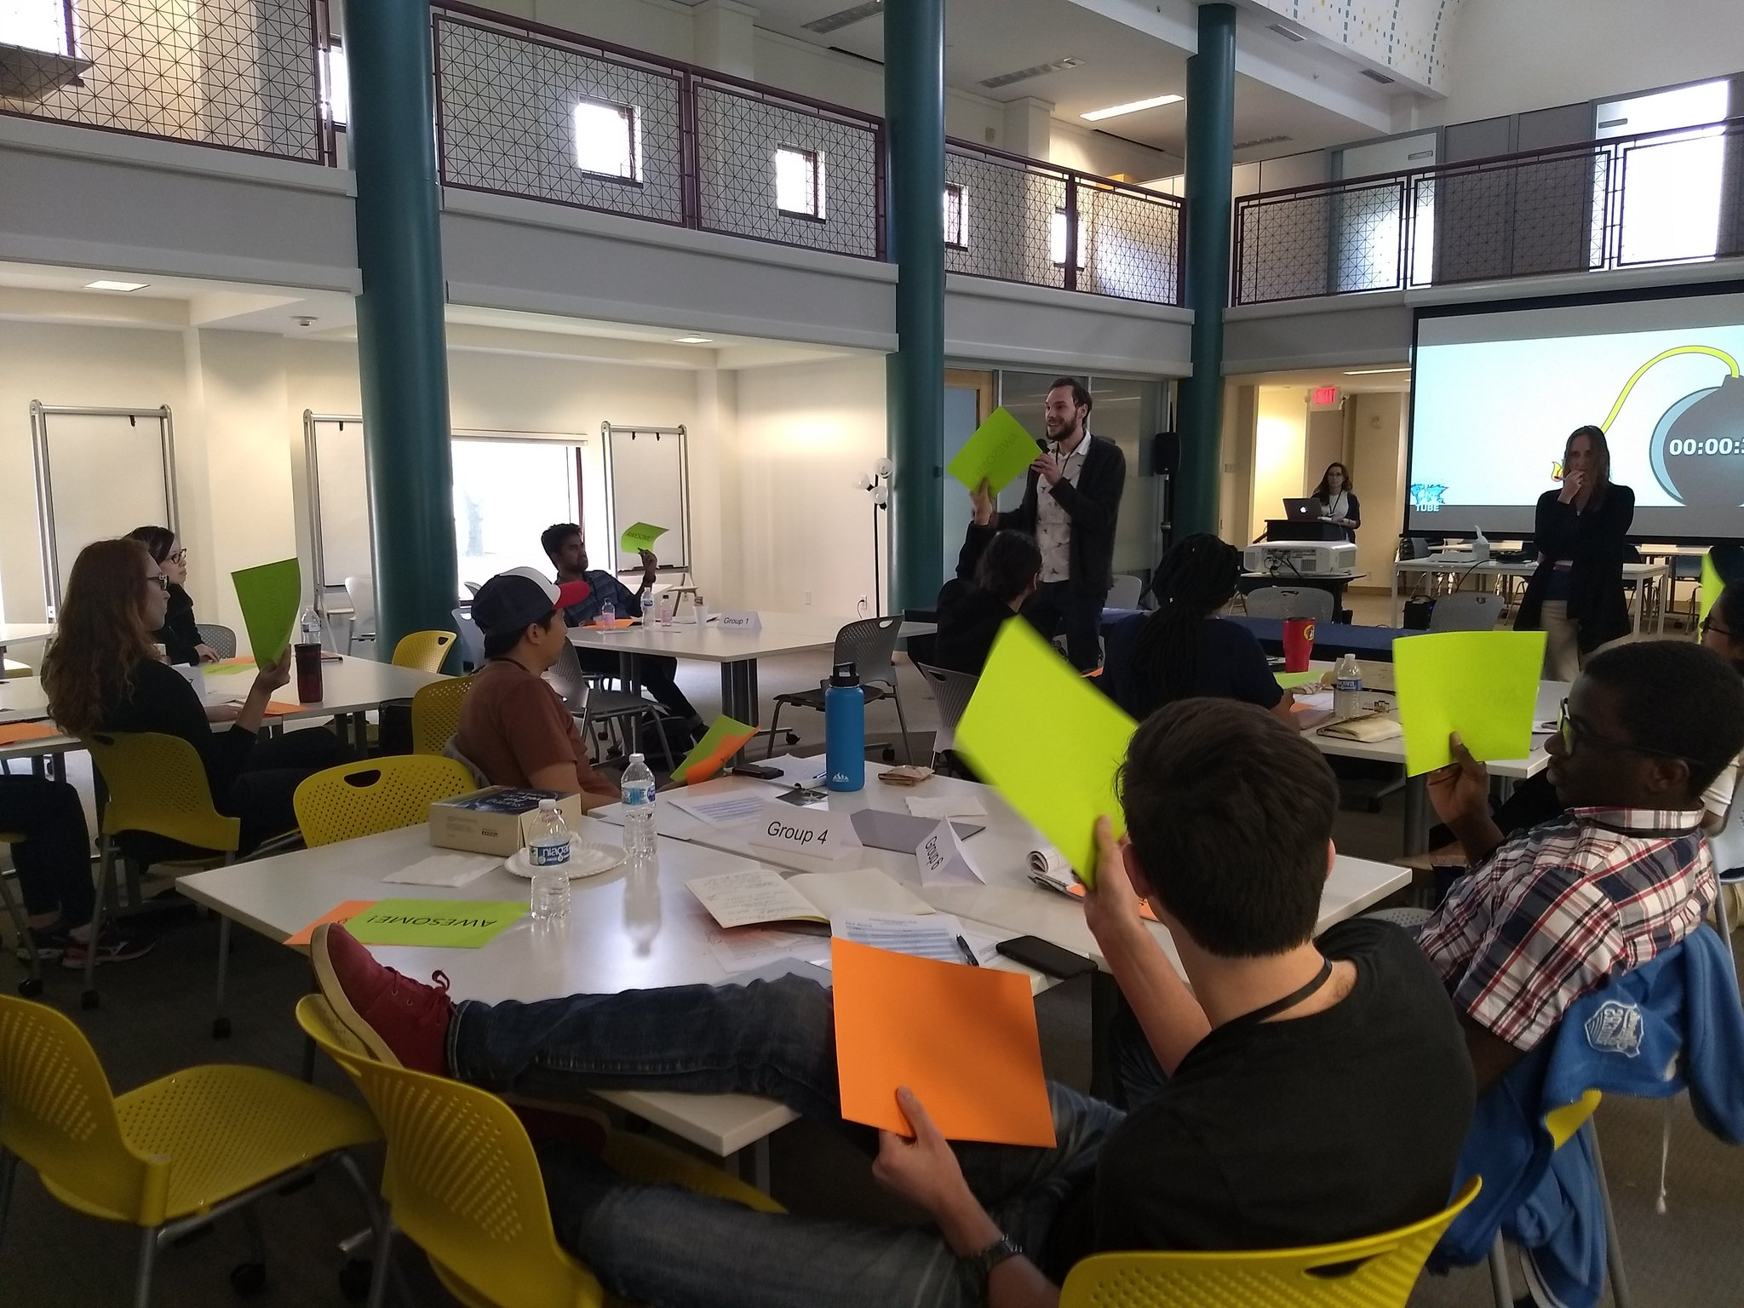
Pop talks
J
T
1 min. research synopsis
Audience feedback
“awesome” and “jargon” handouts

Slide 14
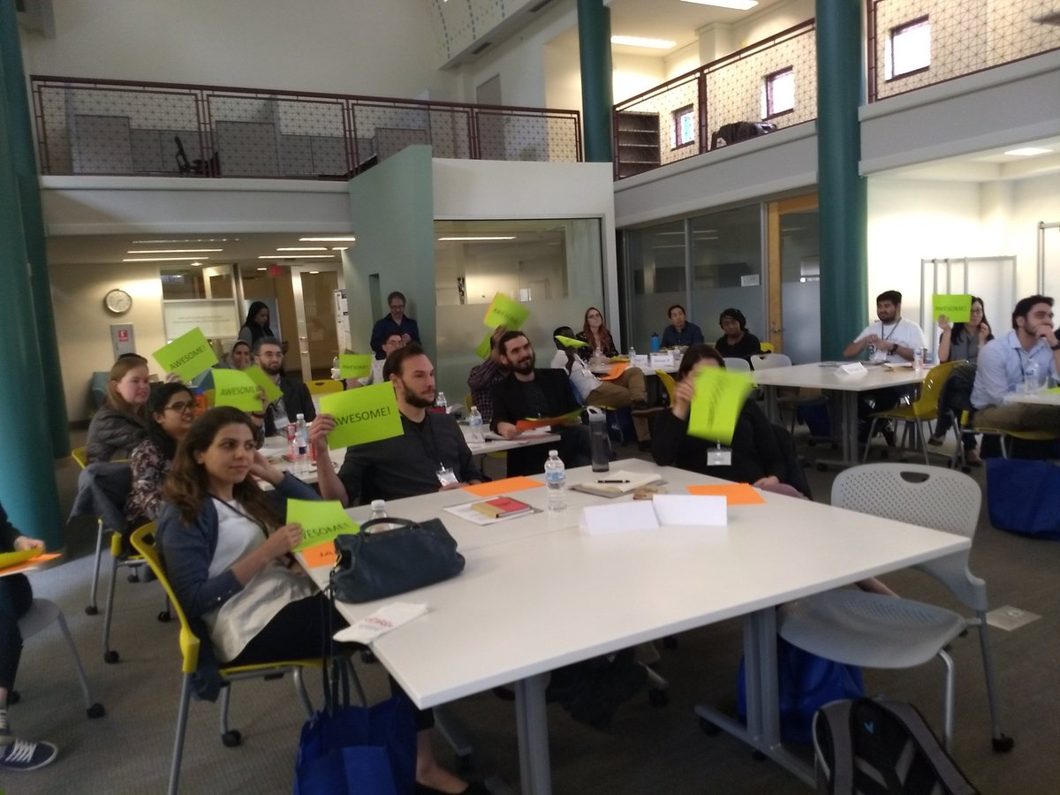
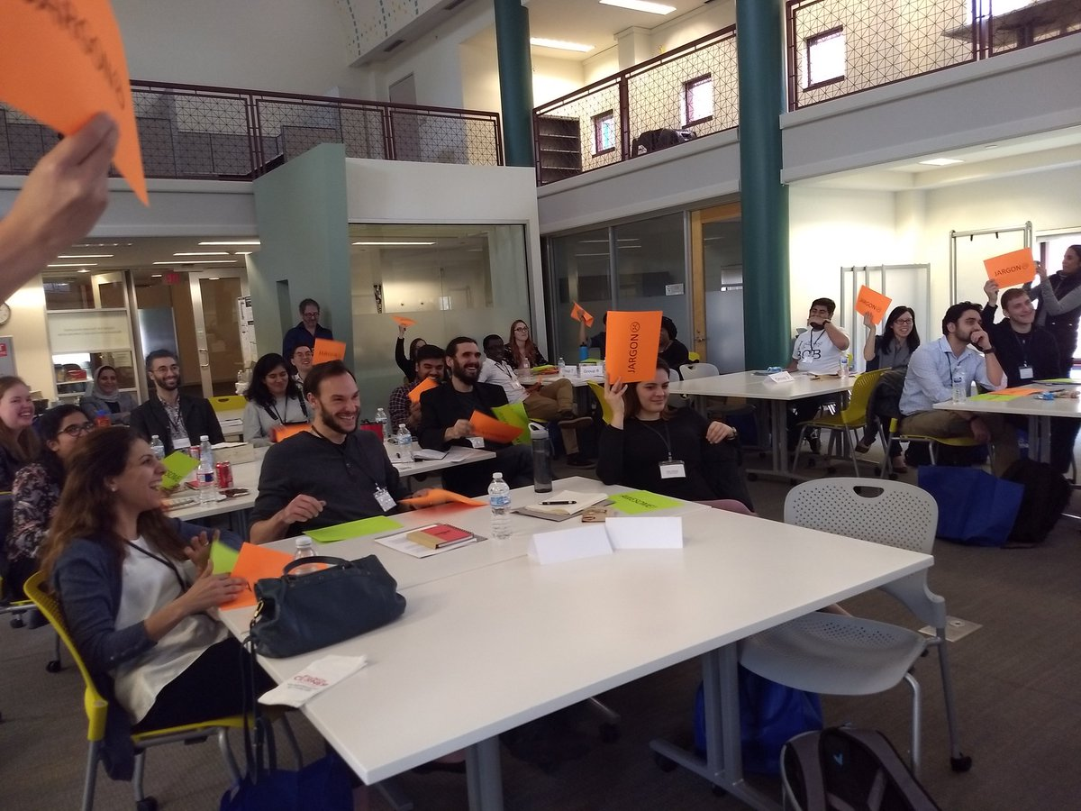
Pop talks
J
T

Slide 15
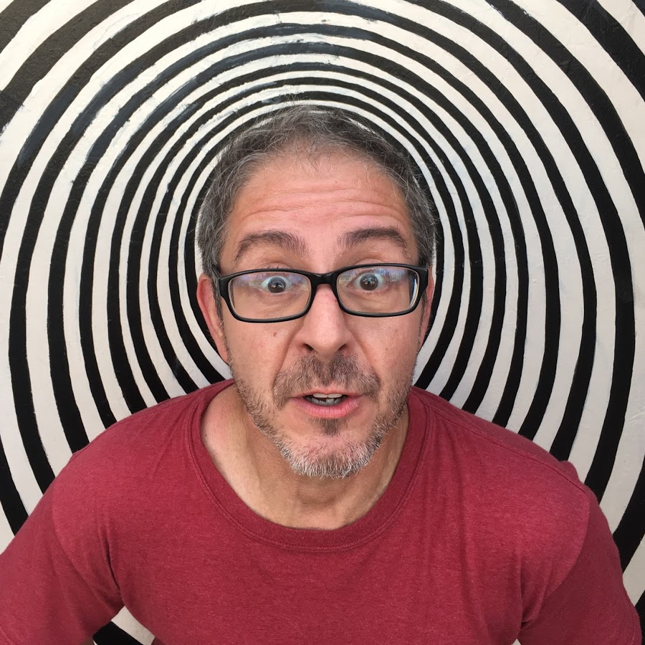
A Science Comedian’s Guide to Communicating Science
J
Brian Malow (@sciencecomedian)
Be:
Present
Passionate
Yourself
Present
Human

Slide 16
A Science Comedian’s Guide to Communicating Science
T
“You can’t teleport me” – B.M. on how an idea has to start where the audience is and can’t skip any logical steps
Great bit on how birds are literally dinosaurs
“Colonel Sanders built an empire on a recipe for fried dinosaur.” - B.M.

Slide 17
Between days
J
T
Submitted draft
A few days for peer review
Revised draft before Day 2

Slide 18
Day 2

Slide 19
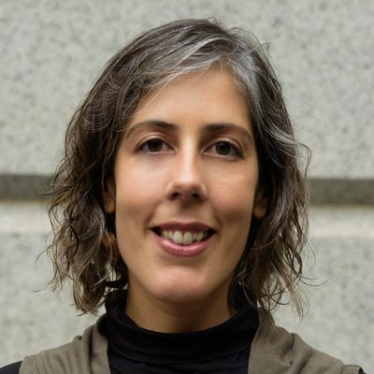
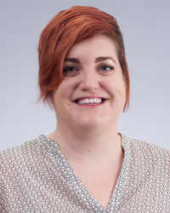
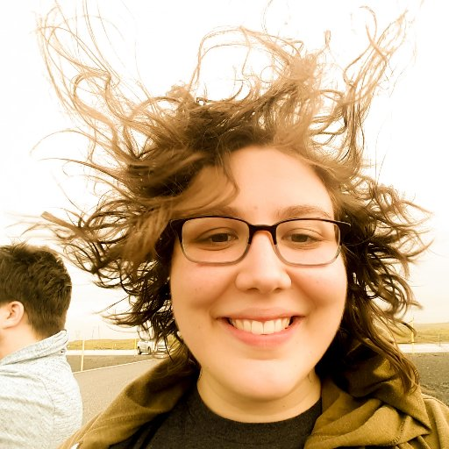
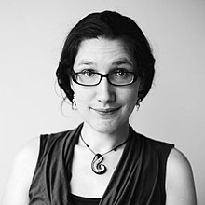
Panel: Science Communication for Diverse Audiences: Beyond Science Writing
J
T
Format was several talks, then Q&A
Diana Marques (@diana_c_marques)
Stavana Strutz (@TexasSandfly)
Anneli Joplin (@AnomalyJoplin)
Organizer of Rice Visual Communication Symposium
Mika McKinnon (@mikamckinnon)

Slide 20
Panel: Science Communication for Diverse Audiences: Beyond Science Writing
J
T
“Your taste will always exceed your ability” – M.M. on being okay with imperfection
“I was flailing & desparate & needed money…turns out I don’t care about rejection” – M.M. on the value of submitting LOTS of proposals and being denied

Slide 21
Editing workshop
J
T
James worked with Kyung-Hee Bae, director of Rice Center for Academic & Professional Communication (CAPC)
“You’re the only one who cares!” – K-H. B.
Tarini worked with Dr. Maurice Wilson, assistant director in the writing center at the University of Houston
Even as a grad student, you count as an expert

Slide 22
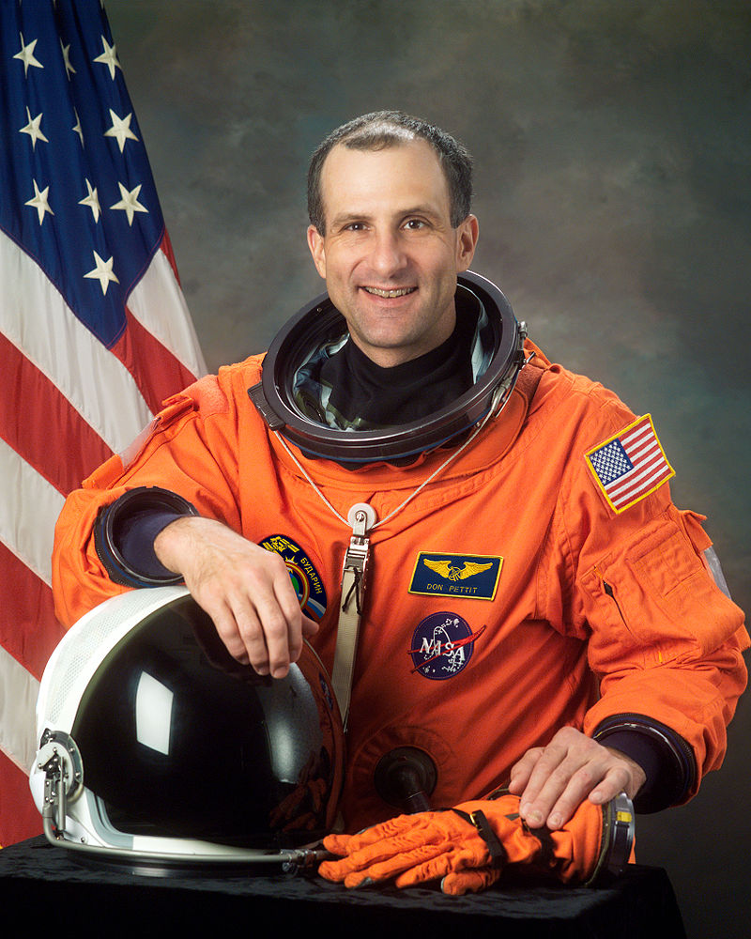
Keynote: Goofing around on ISS
J
T
Astronaut Don Pettit
Goofing around on ISS: films, candy corn, Van de Graff, etc.
Find the frontier and go there and make observations
The rules are different on the frontier!
Exploration is what happens “when you turn your brain loose on a Saturday night in the lab.”

Slide 23
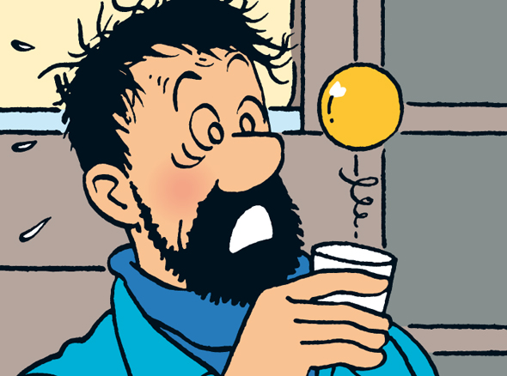
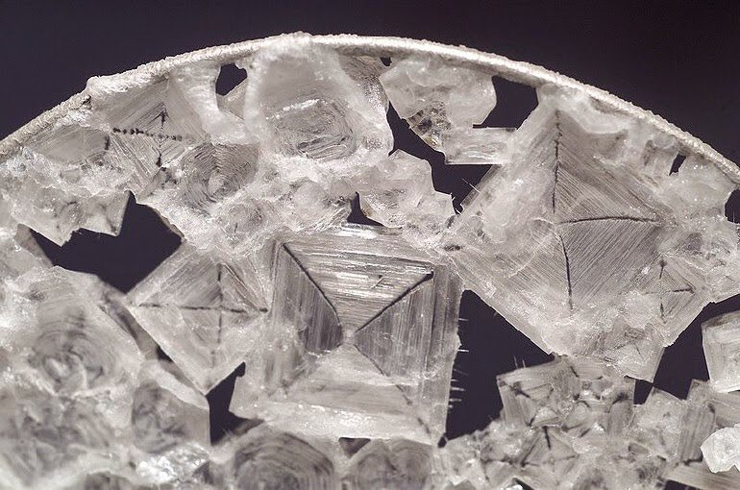
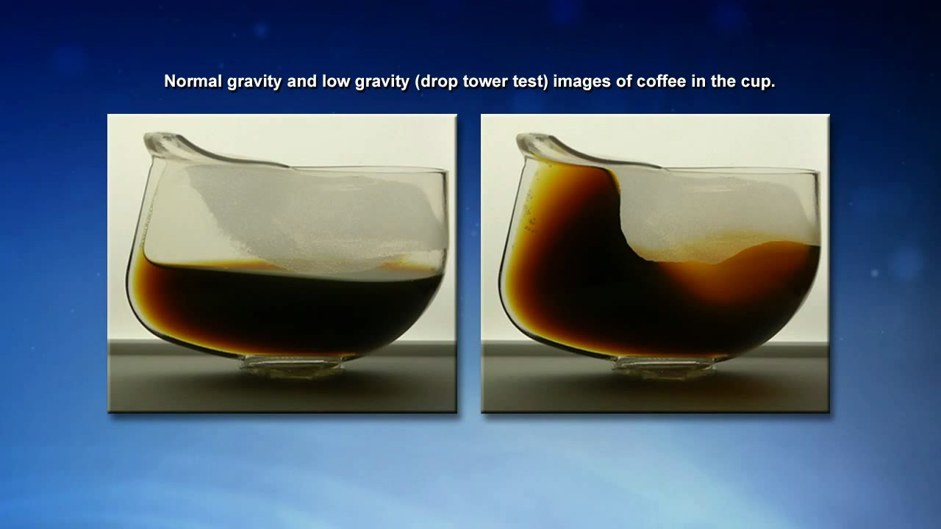
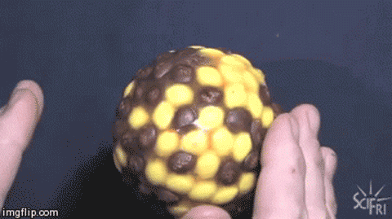
Keynote: Goofing around on ISS
J

Slide 24
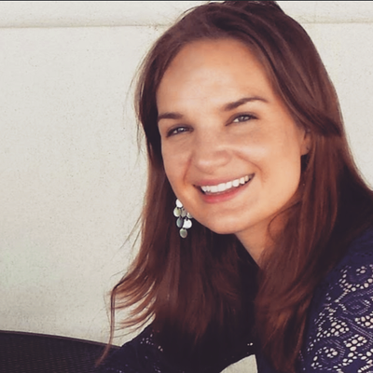
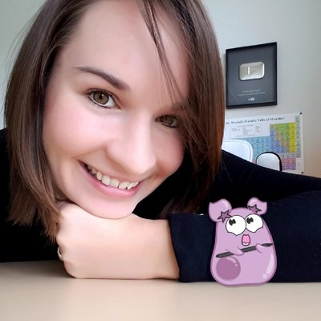
Workshop: Communicating Science with GIFs
T
Brianna Rapini and Sarina Peterson (@AmoebaSisters)
Several tools for making GIFs
Live GIF creation session
GIFs created during the workshop: https://padlet.com/amoebasisters/gifs
Make your own! https://brush.ninja/

Slide 25
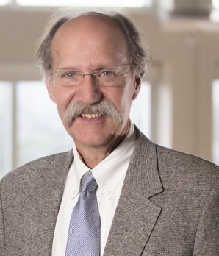
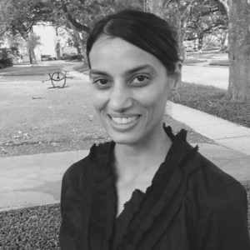
Panel: Science Policy
J
Stephen Linder
Associate Director, Health Policy Institute at Texas Medical Center
Rekha Lakshmanan
Director of Advocacy and Public Policy for The Immunization Partnership
Mika McKinnon
Former physics lobbyist for the American Institute of Physics, an analyst for FEMA

Slide 26
Panel: Science Policy
J
T
Easily the most depressing part of the event
…but also informative!
Build consensus
Tactful engagement
Keep trying, BUT don’t try to convince the unconvinceable
Fact bombardment doesn’t work

Slide 27
So, what did we come away with?

Slide 28
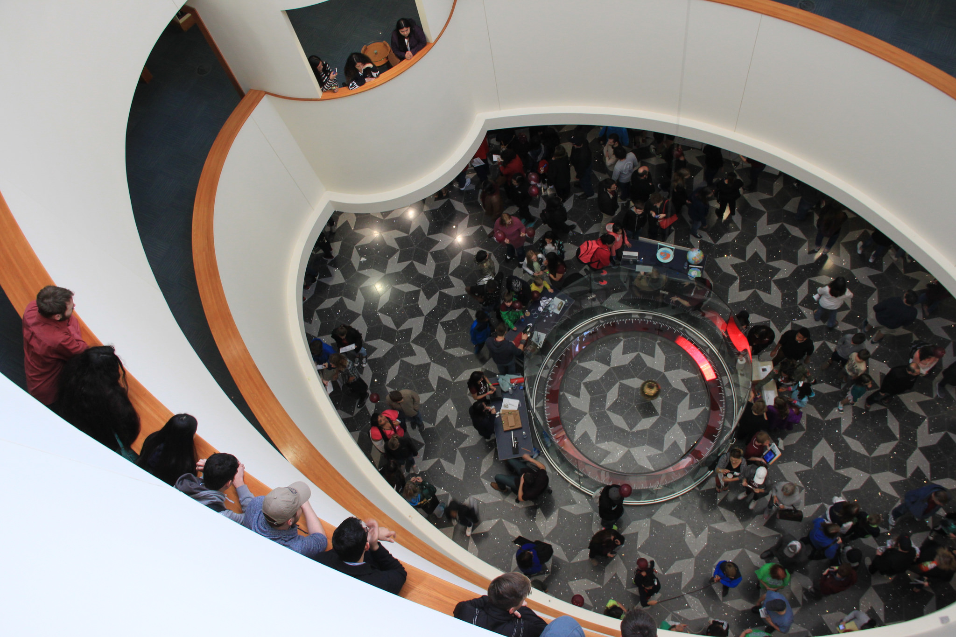
Thank you!

Slide 29
Misc. Resources
Other organizations
ComSciCon / ComSciConHou
Rice PWC, @RiceCAPC
MinorityPostdoc.org
Open Notebook
https://www.theopennotebook.com/pitch-database/

